Slide 1
A Data Analysis of Botulism
By: Beatrice Lee and Rayna Fladell

Slide 2
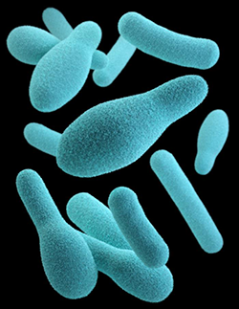
Point of Interest and Purpose
Looking at botulism data and how it has affected multiple populations, particularly in the United States
Cross comparison, better understanding of the disease
Since Botulism is such a rare disease, not many statistical conclusions have been made about it

Slide 3
Data Collection
Data sets were initially difficult to find
Used data from the websites suggested and our knowledge of code to help us choose the data sets
Looked mostly at governmental data, particularly from the Center of Disease Control
Wanted to find data that met the criteria which could be scrapped and used in a meaningful way

Slide 4
Data Cleaning Process
Corrected for any inconsistencies in the data
Pulled data from each file that would be useful for the project
Used the categories that were across multiple data sets to make it easier to organize and use
Organized all of the data into similar file types for ease of use

Slide 5
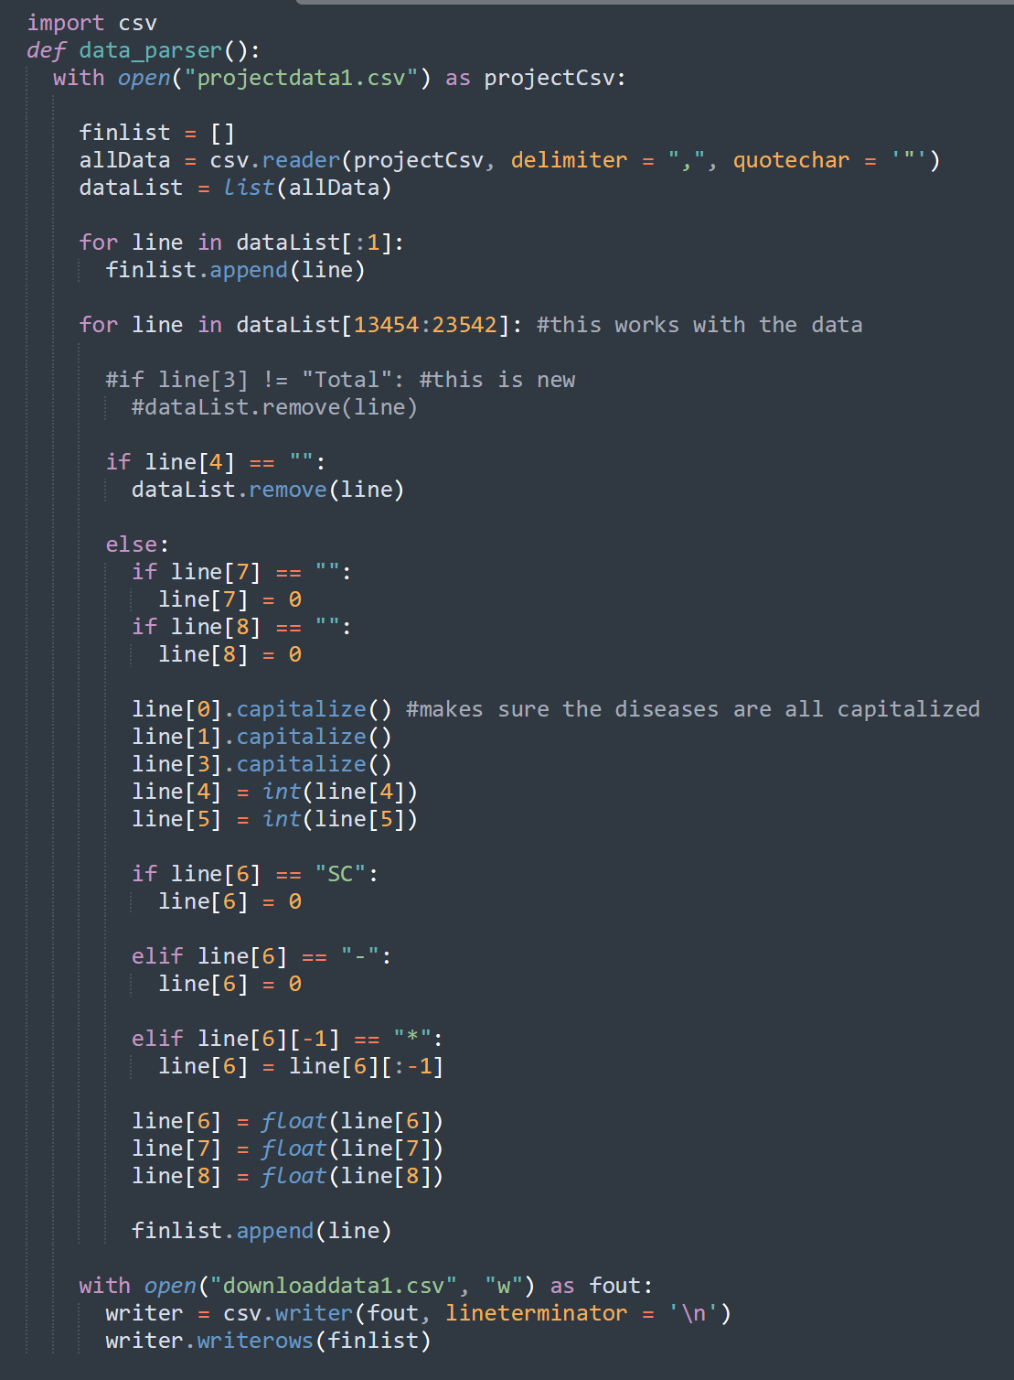
Data Cleaning Process
CSV module
String Methods
Export to CSV File

Slide 6
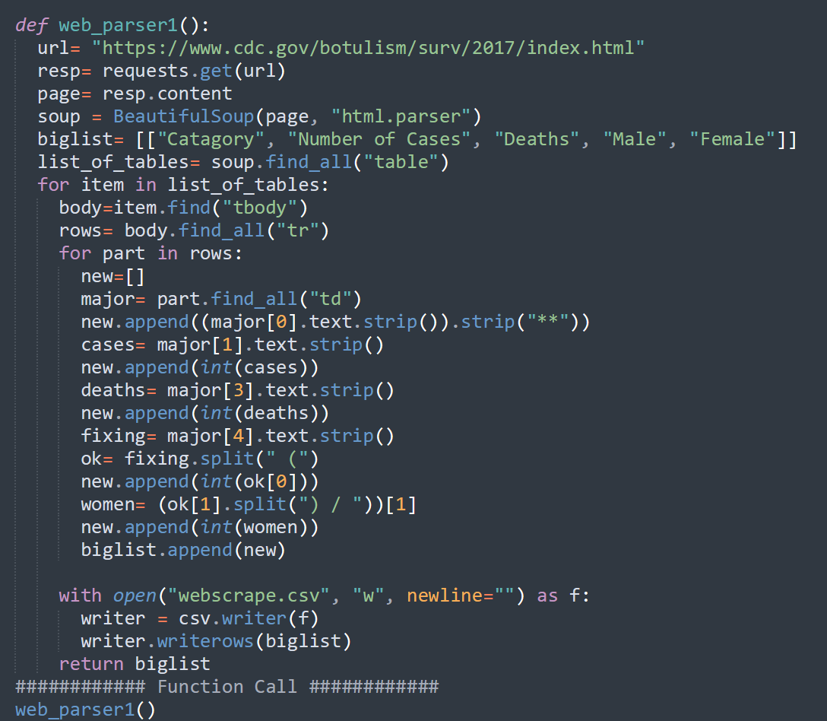
Data Cleaning Process
Beautiful soup, requests, re
Sifted through stacked tables and data
Cleaned and formatted data

Slide 7
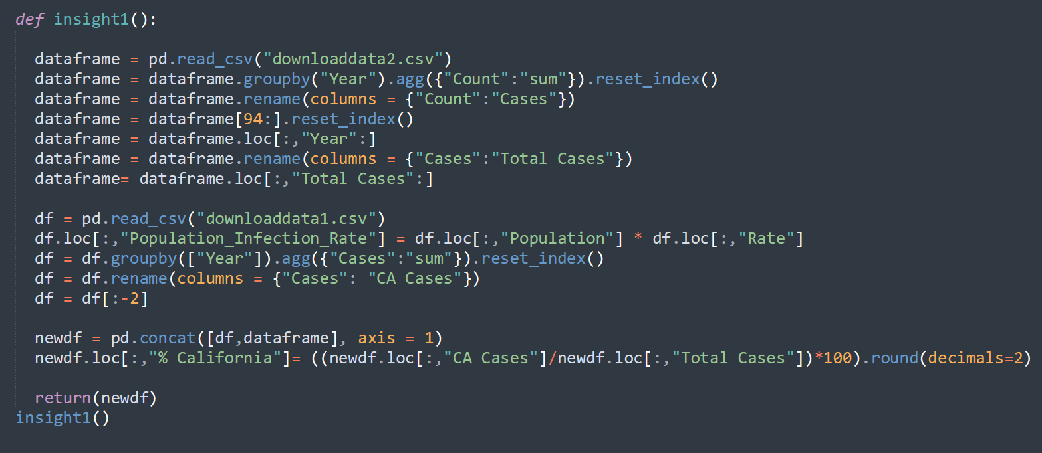
Insight 1

Slide 8
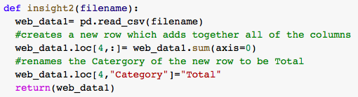
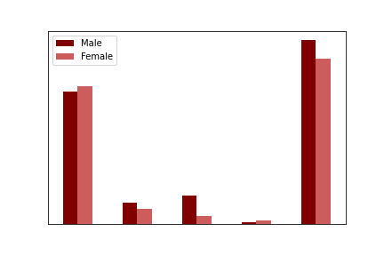
Visualization 1 & Insight 2

Slide 9
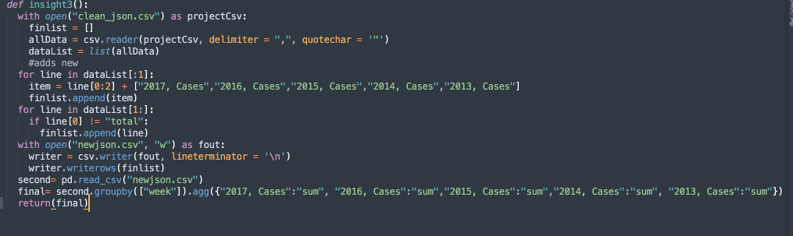
Insight 3

Slide 10
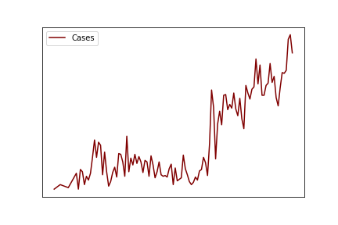
Visualization 2

Slide 11
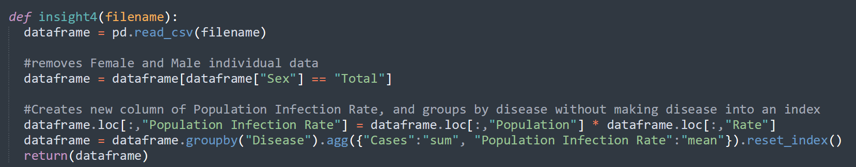
Insight 4

Slide 12
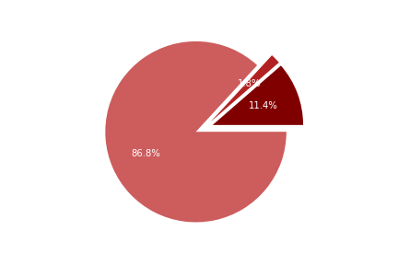
Visualization 3

Slide 13
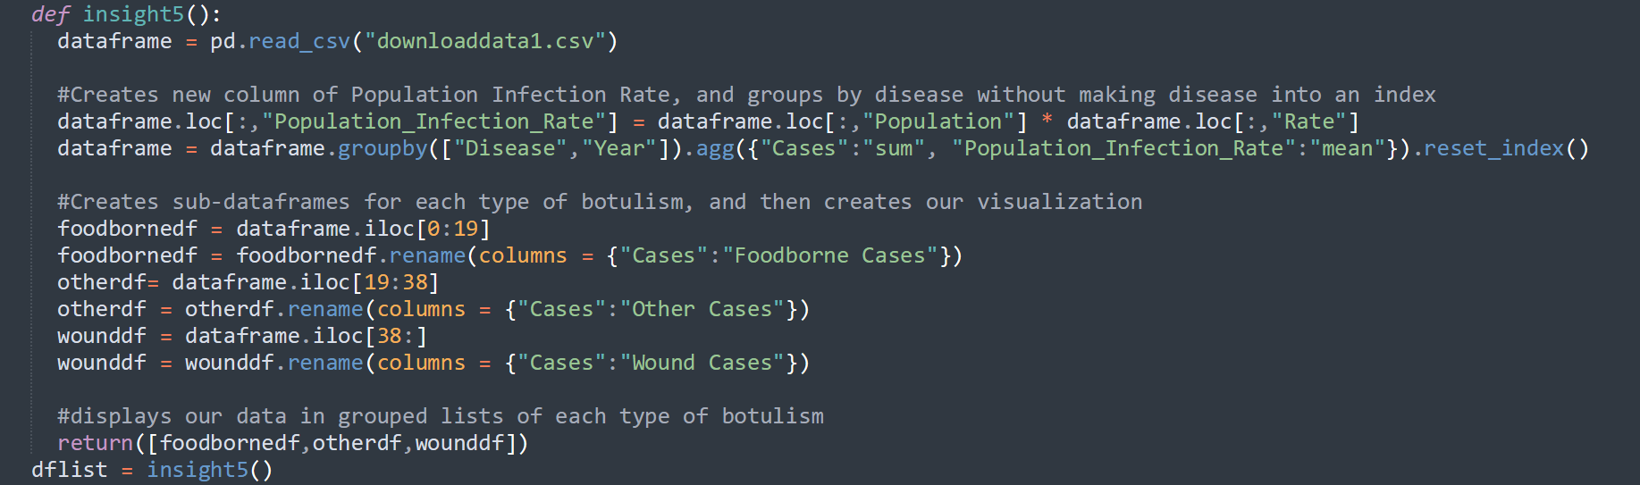
Insight 5

Slide 14
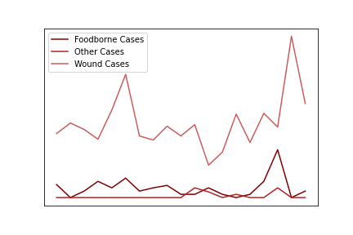
Visualization 3
Visualization 4

Slide 15
Challenges & Wrap-Up
It’s different when the data is not collected for you
Recognizing inconsistencies across sources
Websites are not designed for people to collect data
Skills learned in class were a helpful jumping off point but each dataset is unique

